Slide 1

Pre-Proposal Conference
Houston Independent School District
Purchasing Services Department
RFP #27-09-07 / Dedicated Internet Access (E-Rate Eligible)
October 7, 2027
Notes:
Good morning, everyone and welcome to the Pre-Proposal Conference for Houston ISD Purchasing Services RFP # (enter project #s and name names)
My name is (Enter CS name), and
Today is (date)

Slide 2
AGENDA
House Rules
Scope of Work
Project Timeline
Business Assistance Office (HUB Participation Plan)
Risk Management Office (Liability Insurance Compliance)
Ethics and Compliance Office (Criminal History Background Check Information)
Code of Silence and Conflict of Interest
Vendor Proposal Submission (IonWave)
Notes:
On Today’s agenda we will be reviewing the House Rules, a brief overview of the project timeline, The Business Assistance MWBE Participation, Risk Management’s Insurance Requirements, our Code of Silence, and the proposal submission forms and overview.

Slide 3
Pre-Proposal Conference House Rules
To avoid unnecessary distractions and remain mindful of everyone’s time:
    Cameras should NOT be active during the meeting.
    Microphones must be muted at all times.
    Verbal questions will not be entertained. All questions must be submitted via the IonWave electronic bidding portal under the “Questions” tab. Answers to questions received in IonWave will be answered within IonWave periodically and through the last day for questions indicated in the solicitation documents.
This presentation and meeting attendance roster will be posted within IonWave in the form of an addendum and will be available for viewing within the “Attachments” tab.
Notes:
Now for our house rules for today’s pre-proposal, to avoid unnecessary distractions and remain mindful
of everyone’s time, all cameras and microphones should be left off at all times. No verbal questions will be entertained and must be submitted via Ionwave by (questions cutoff date and time), we will be providing answers periodically.

Slide 4
Code of Silence (Board Policy CAA (LOCAL))
Code of Silence and Conflicts of Interest: The Board of Education (Board) has adopted a “Code of Silence” policy (ref. Board Policy CAA (Local)) and a “Conflict of Interest Disclosures” policy (ref. Board Policy BBFA (Local)) to enforce its commitment to ethical contracting standards and improve accountability and public confidence. It is important to avoid both the appearance of conflicts and actual conflicts of interest.
The “Code of Silence" shall mean a prohibition on any communication regarding any RFP/RFQ, bid, or other competitive solicitation between:
  Any person who seeks an award from the District or its affiliated entities (including, but not limited to, the HISD Foundation and the HISD Public Facility Corporation), including a potential vendor or vendor's representative, and
  Board members, the Superintendent of Schools, senior staff members, principals, department heads, directors, managers, or other District representatives who have influence in the evaluation or selection process.
The Code of Silence period shall begin when the Solicitation is issued and end upon approval of the award by the HISD School Board. During the Code of Silence period, campaign contributions, gifts, donations, loans, and any other items of value are prohibited between these parties, including candidates who have filed for election to the Board.
Notes:
Now a brief overview of our code of silence.
The purpose of the code of silence is to enforce the district and the board’s commitment to ethical contracting standards and to improve accountability and public confidence.
The Board of Education has adopted a “Code of Silence” policy and a “Conflict of Interest Disclosures” policy enforce its commitment to ethical contracting standards and improve accountability and public confidence. It is important to avoid both the appearance of conflicts and actual conflicts of interest.
The Code of Silence" shall mean a prohibition on any communication regarding any RFP, bid, or other competitive solicitation between any person who seeks and award from the district or its affiliated entities, including a potential vendor or vendor’s representative and board members, the superintendent, senior staff members, principals, department heads, directors, managers, or other district representatives who have influence in the evaluation or selection process.
Both the Code of Silence and the Conflict of Interest forms are referred to throughout the proposal documents.

Slide 5
Scope and Specifications
SCOPE OF WORK: The Houston Independent School District (HISD) seeks one or more qualified organization(s) to provide:
Dedicated Internet Services (E-Rate Eligible).
    Market Basket 1: HMW - 4400 W 18th St, Houston, TX 77092 -
    Market Basket 2: Braxton - 3960 Braxton Dr, Houston, TX 77063 -
    Market Basket 3: Databank - 4201 Southwest Freeway, Houston, TX 77027 -
    Market Basket 4: Element Critical (Skybox) - 22000 Franz Rd, Katy, TX 77449 -
Please refer to the Scope of Work section of the solicitation document (Part I – Scope of Work, Specific Conditions, and Technical Specifications) to review the full details of the goods and/or services requested by HISD.
Notes:
Specifics and details are provided in the RFP documentation, but in short, HISD is soliciting direct delivery to schools of fresh baked bread and fresh produce. This project is expected to begin (tentative start date) and be renewed annually for an additional (renewal terms) upon mutual agreement and review.
Please keep in mind that this term start date is tentative and subject to change.

Slide 6
This is an E-Rate eligible project
You must be an E-Rate approved vendor to submit a proposal. All vendors submitting a proposal must provide your Service Provider Identification Number (SPIN) and evidence of FCC Green Light status.
Please see RFP Part I, Section III Specific Conditions for E-Rate qualifications.

Slide 7
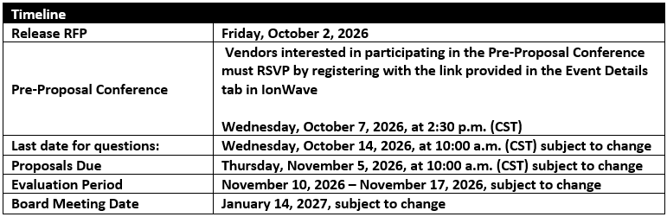
Project Timeline
A detailed timeline of events associated with this solicitation is found under RFP 27-09-07 Agreement Part I, which may be accessed in IonWave under the “Attachments” tab. This timeline is subject to change.
Notes:
On to our timeline details, this RFP was released on (issue date), today is our preproposal conference, the last day for questions will be (question cutoff date and time), all proposals are due (close date) by (close time) no late submissions will be allowed or accepted. Our evaluation period will be from (evaluation period dates), and the board meeting date will be (date). This timeline is subject to change, any updates will be communicated via Ionwave.

Slide 8
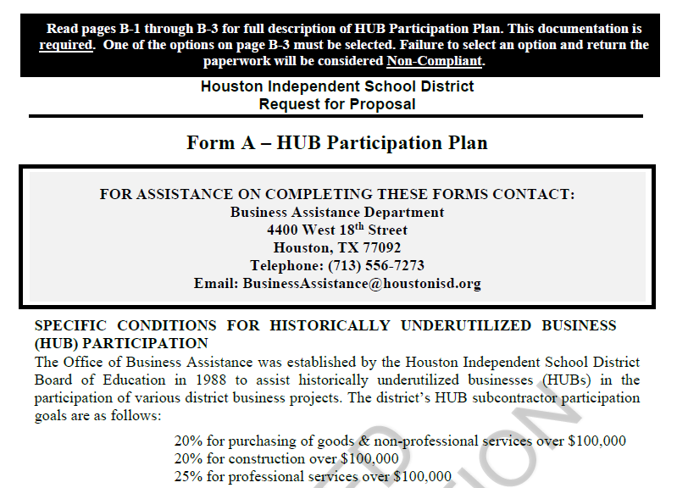
BUSINESS ASSISTANCE OFFICE
Form A: HUB Instructions and Participation Plan
To meet HUB deadlines, please begin documentation as soon as possible.
All questions regarding district HUB requirements should be directed to:
Business Assistance Office
BusinessAssistance@houstonisd.org.
Tel. 713-556-7273
Business Assistance Video
Notes:
Now we will watch a short video overview of the Business Assistance Form B MWBE Participation Report *show video* If you have any questions regarding the MWBE participation report, please reach out to the Supplier Diversity Department at 713-556-7273.

Slide 9
RISK MANAGEMENT OFFICE
Insurance Requirements
Type of Coverage Minimum Limits
1. Workers’ Compensation Statutory
and Employer’s Liability $100,000 per accident
2. Automobile Liability:
Bodily Injury & Property Damage $1,000,000 Combined Single Limit
For all owned, non-owned vehicles and
hired vehicles.
  Commercial General Liability $1,000,000 Combined Single Limit
4. Professional Liability (errors and omissions) may be required at the discretion of the Project Manager
  NOTE: HISD shall be named as an alternate employer on the workers’ compensation policy.
***This is REQUIRED. Non-compliance will disqualify vendors from this bid opportunity.***
All questions regarding district insurance requirements should be directed to:
HISD Risk Management Office
Video
Representative Name: Tonya McKinney
Representative Email: Tonya.McKinney@houstonisd.org
Representative Phone: 713-556-9225
Notes:
Next, we have another short video from our Risk Management Department providing an overview on the Insurance Requirements *show video*, again if you have any questions please reach out to our Risk Management Department at 713-556-9225

Slide 10
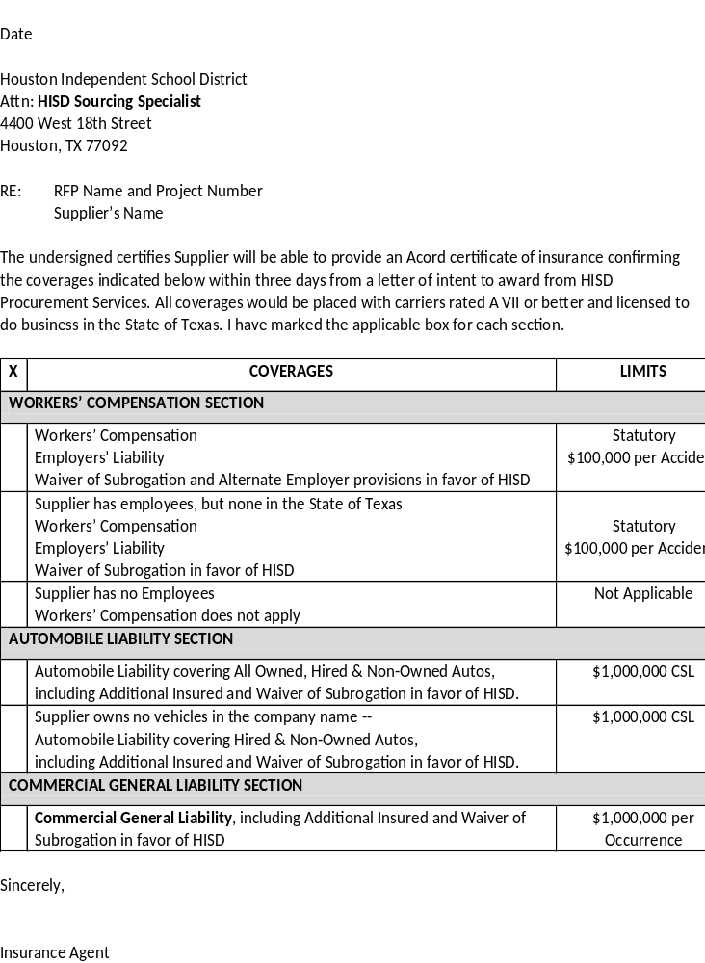
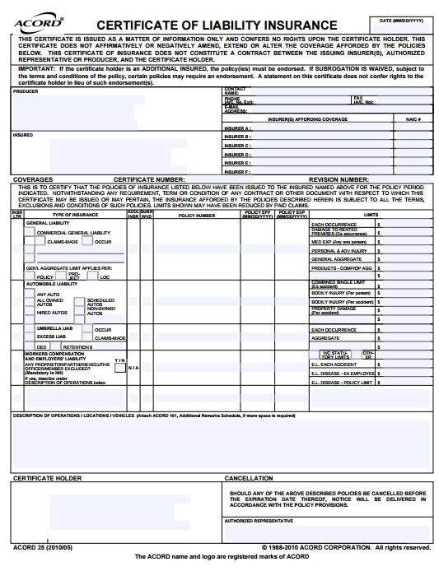
Samples of Insurance Letter and ACORD Form

Slide 11
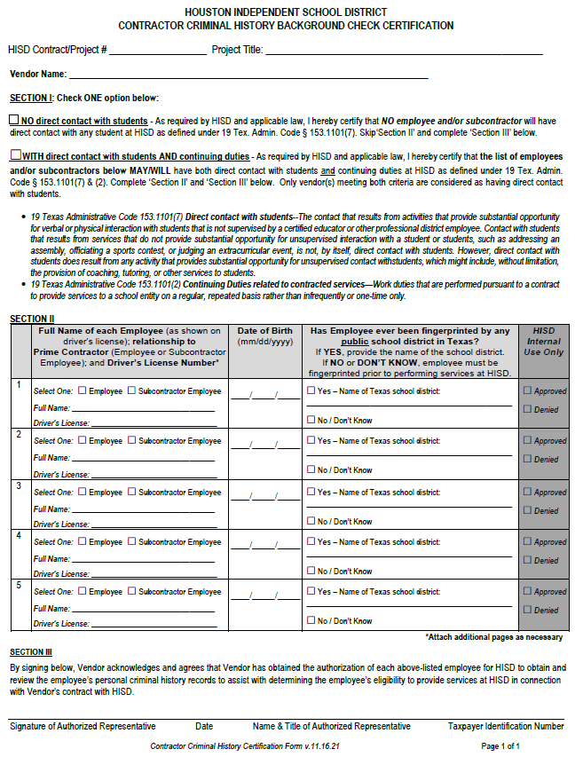
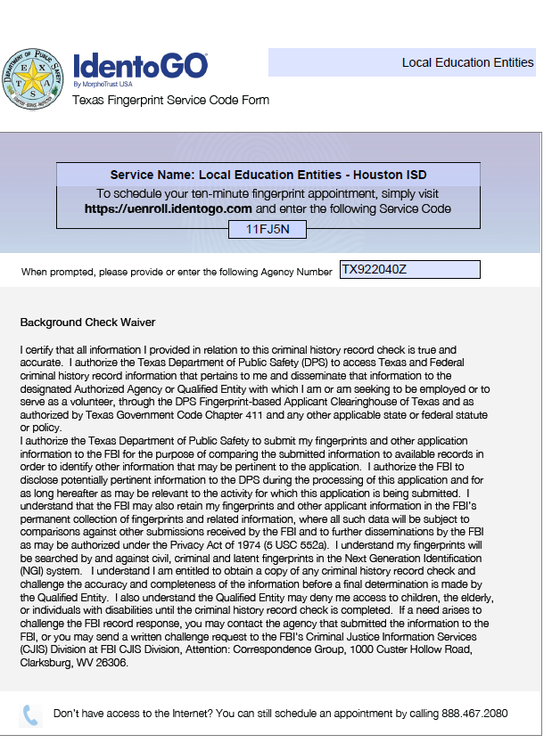
ETHICS & COMPLIANCE
Criminal History Background Check
Does this project involve direct, unsupervised contact with students?

Slide 12
Proposal Submission Overview
Vendor questions and proposals must be submitted via the HISD electronic bidding portal (IonWave). Answers to questions will also be posted online.
Click on the link below to register in IonWave and access all the solicitation documents: https://houstonisd.ionwave.net/Login.aspx
Notes:
As listed in the RFP, all bids must be submitted via Ionwave by the project close date.
We will now have a brief overview of Ionwave and the required proposal submission documentation.

Slide 13
IonWave Navigation
Event Details
Questions
Attachments
Attributes
Response Attachments
Response Submission (electronic signature)

Slide 14
Thank you!
Houston ISD Purchasing Services thanks you for attending this pre-proposal conference and for your interest in doing business with HISD.
Please remember that late submissions are not accepted, so don’t miss this opportunity and submit your proposal early!

