Slide 1

Welcome
September 2026 Solicitations
Pre-Proposal Meeting

Slide 2
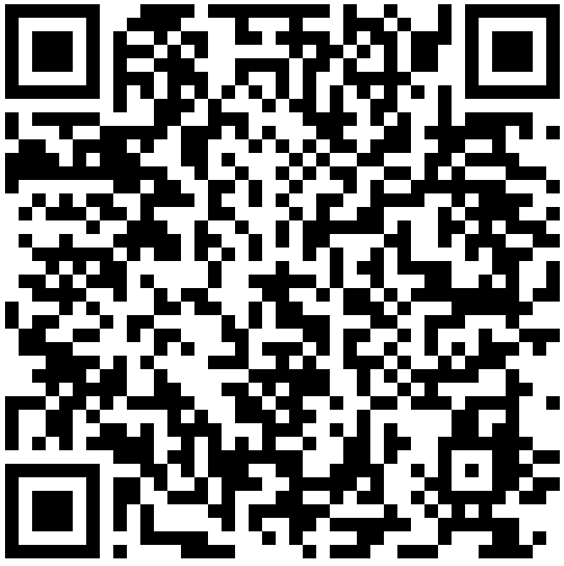
State of Indiana Bidder Profile
A bidder profile with IDOA is required to access the Indiana Supplier Portal and to submit bid responses.
Scan the QR Code to access Supplier Portal Information.
Before an award may be granted, the bidder must be registered with the Secretary of State

Slide 3
Pre-Proposal Breakout Meeting Information
Topics for event-specific sessions:
  Key Dates
  Term of Contract
  Purpose of RFP
  Scope of Work
  Q&A
  The specific location(s) and time(s) of each Breakout meeting will be listed on the last slide.
Notes:
Key dates include: Issuance of the RFP, Deadline to submit the preproposal networking form and written questions, responses to questions/RFP amendments, deadline for submission of proposal (incl all required documents), deadline for submission of ref. check forms, and the anticipated time for preliminary award.

Slide 4
Pre-Proposal Main Meeting Information
General Information
Proposal Preparation
Evaluation Criteria
Indiana Veteran Owned Small Business Enterprises (IVOSB)
Submission Requirements
  Optional Forms/Documents
  Required Forms/Documents
Additional Information
Questions (Attachment G)

Slide 5
General Information
Potential Respondents are typically given the opportunity to express interest in a solicitation and to have their company and contact information posted to the solicitation website by submitting the Pre-Proposal Network Opportunities Form (Attachment I).
  The form is optional but must be submitted to rfp@idoa.in.gov by the date and time specified in the documents for each solicitation.
Potential Respondents are encouraged to submit any questions pertaining to a solicitation via the Question/Inquiry process, using Attachment G.
Specific deadlines for each event are listed in the published solicitation document(s) (RFP Main Document).
Notes:
Potential Respondents = Both Primes and Subs.
Remember that only questions/answers provided in writing may be considered binding on the State.

Slide 6
Submission Forms/Documents
Additional forms may also be required depending on the event.
Use the templates provided for all responses and do not alter any templates.
Responses must be submitted per the RFP instructions. See RFP Sections 1.7 and 2.1 for additional details. Late submissions and emailed or hand-delivered submissions will not be accepted.
Please see the Key Dates section (RFP Section 1.23) of each solicitation to confirm due dates for these items.

Slide 7
Required Submission Forms/Documents
Attachment A – IVOSB Participation Plan Form
  Letters of Commitment
  Certification Documentation
Attachment D – Cost Proposal Template
Attachment E – Business Proposal Template
Attachment F – Technical Proposal Template
Attachment H – Reference Check Forms
  Must be completed by the reference and emailed directly to the State
Attachment J – Attestation Form
Notes:
Cloud Questionnaire and Infrastructure Overview Forms

Slide 8
Executive Summary
The Executive Summary must be completed and submitted via the online submission process. At a minimum, your Executive Summary must address the following (also outlined in Section 2.2 of the RFP):
Summarize your ability and desire to supply the required services;
Make sure the Executive Summary is signed by an authorized representative;
  Include your primary contact
State your understanding of the respondent notification.
You may include additional “cover letter” information within the Executive Summary if desired.

Slide 9
Attestation Form
The Attestation Form (Attachment J) must be completed.
Mandatory Submission and Requirements
Confirm Mutual Understanding and Submission
Claim Clarification (Buy Indiana), if applicable
Claim Clarification (Qualified Agency), if applicable
Confidential / Redacted File Information
Authorizing Document
Secretary of State status indication

Slide 10
Confidential Information
Confidential Information (RFP Main Document - Section 1.14)
All materials contained in proposals are subject to the Access to Public Records Act (APRA) and can be accessed by any member of the public after contract award. The responses are deemed to be “public records” unless a specific provision of IC 5-14-3 protects parts of the response from disclosure.
In order to request certain information be kept confidential, Respondents must claim a statutory exception to the APRA in their Attestation Form (Attachment J), including a description of which specific provision applies to any specific part of their response.
Confidential information must also be clearly marked and kept separate from the proposal in the electronic copies. IDOA recommends sending a “public” file that has the confidential information redacted (may be in PDF format) and a “final” file that includes all required information (must be in format provided).
A redacted version must be submitted along with the Confidential copy.
DO NOT LABEL YOUR ENTIRE RESPONSE AS CONFIDENTIAL.

Slide 11
Cost Proposal
Attachment D
Please complete the template provided for the Cost Proposal by populating ONLY the blue shaded cells. The Total Cost will populate automatically. The Cost Proposal must be returned in the original Excel format. (No PDFs.)
Cost Proposals are scored based on the Total Cost for the initial term. Using an estimated 30-point score for the Cost, the lowest cost proposal receives a total of 30 points. The normalization formula is as follows:
Respondent’s Cost Score = (Lowest Cost Proposal / Total Cost of Proposal) X 30
Notes:
(Total Cost in cell E8of the Cost Proposal)

Slide 12
Cost Proposal
The Respondent should provide a brief narrative (not longer than two pages) in support of each Cost Proposal item and return this document in a PDF format, labeled as “Cost Proposal Narrative.”
The Respondent should list and describe as part of its Cost Proposal any special cost assumptions, conditions, and/or constraints relative to, or which impact, the prices presented on the Cost Schedules. The Respondent should return this document in a PDF format, labeled as “Cost Assumptions, Conditions and Constraints”.

Slide 13
Business Proposal
Attachment E
Company Financial Information (Section 3.0)
  Respondents must provide documents to demonstrate financial stability including, for example, the most recent Dunn & Bradstreet Business Report (preferred) or audited financial statements for the two (2) most recently completed fiscal years. If neither of these can be provided, Respondents must explain why and include an income statement and balance sheet for each of the two (2) most recently completed fiscal years.
  If the documents are from a parent or holding company, Respondents must explain the business relationship between the entities and demonstrate the financial stability of the entity which is directly responding to this RFP.

Slide 14
Business Proposal
Contract Terms (Section 5.0)
  Respondents should review sample State contract and note exceptions to State non-mandatory clauses in Business Proposal and Executive Summary.
  The State may refuse to consider any redlines requested in negotiation of a contract that were not specifically identified and included in a vendor’s response.
Mandatory clauses are non-negotiable.

Slide 15
Business Proposal
References (Section 6.0)
Often, Respondents must have at least three (3) references who:
  Can speak to the Respondent’s experience in providing products and/or services that are the same, or similar, to those products and/or services requested in this solicitation
  Can speak to the Respondent’s performance on contracts of similar scope for government clients
Respondents must ask each reference to complete Attachment H (Reference Check Form) and email it directly to IDOA (idoareferences@idoa.in.gov)
by the date specified in the solicitation.

Slide 16
Technical Proposal
Attachment F
Every point made in each section must be addressed in the order given. The same outline numbers must be used in the response.
Where appropriate, supporting documentation may be referenced by a page and paragraph number. However, when this is done, the body of the Technical Proposal must contain a meaningful summary of the referenced material.
  The referenced document must be included as an appendix to the Technical Proposal with referenced sections clearly marked.
  If there are multiple references or multiple documents, these must be listed and organized for ease of use by the State.

Slide 17
Optional Submission Forms/Documents
Submission of these documents is optional and does not impact your ability to submit a proposal.
Attachment I - Pre-Proposal Networking Opportunity Form
Attachment G - Questions and Answers Form
Please see the Key Dates section (RFP Main Document) of each solicitation to confirm due dates for these items.

Slide 18
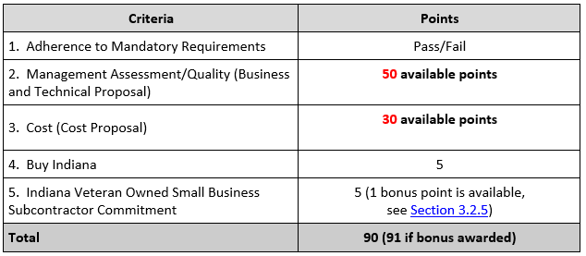
Evaluation Criteria
Notes:
This is an example of our typical eval criteria, but these can vary somewhat from event to event. Be sure to read the RFP carefully.

Slide 19
Indiana Veteran Owned Small Business
Contact Information
  Phone: 317-232-3061
  E-mail: Indianaveteranspreference@idoa.in.gov
  Web: www.in.gov/idoa/2862.htm
Complete Attachment A, IVOSB Form
  Include subcontractor letters of commitment
Goals for Proposal
  3% Veteran Owned Small Business of Total Bid Amount

Slide 20
Indiana Veteran Owned Small Business
Prime contractors should note the following:
Pursuant to 25 IAC 9-4-1(c), a Prime Contractor who is an IVOSB can use their own workforce to count toward the goal.
IVOSB must have a Bidder ID (see Section 1.16).
Prime contractor and/or subcontractors’ Certification Letter(s), provided by IDOA must accompany the proposal to show the current status of certification.

Slide 21
Indiana Veteran Owned Small Business
Prime contractors must ensure that the proposed subcontractors meet the following criteria:
Must be listed on the IDOA Directory of Certified Firms, on or before the proposal due date.
Serve a Valuable Scope Contribution (VSC) on the engagement, as confirmed by the State.
  Valuable Scope Contribution – A business function that supports the scope of this solicitation.
Provide the goods or services specific to the contract and within the industry area for which it is certified.

Slide 22

Indiana Veteran Owned Small Business
Process. IVOSB scoring is conducted based on 5 points plus a possible 1 bonus point scale.
  IVOSB: Possible 5 points + 1 bonus point
Professional Services Scoring Methodology. The points will be awarded on the following schedule:
Fractional points will be awarded based upon a graduated scale between whole points. (e.g., a 0.3% commitment will receive .5 points, and a 1.5% commitment will receive 2.5 points)
Submissions of 0% participation will result in a deduction of 1 point in each category
The highest submission which exceeds the goal will receive 6 points (5 points plus 1 bonus point). In case of a tie both firms will receive 6 points.

Slide 23
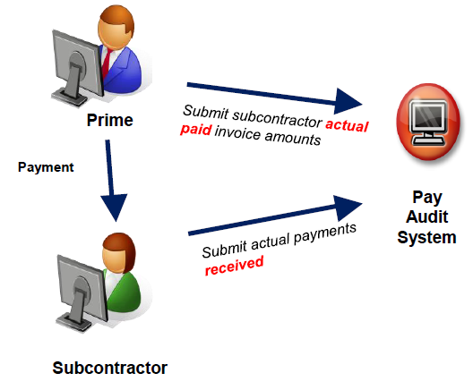
Subcontractor Compliance
Pay Audit System
Tool utilized to monitor the state’s diversity spend for subcontractors
Selected primes and subcontractors are required to report payments submitted or received through this web-based tool
Based on contract terms, payments should be reported monthly or quarterly

Slide 24
Submission Requirements
You must be a registered bidder to submit a proposal.
  Please refer to Section 1.16 of the RFP document for instructions regarding the online submission process using the Supplier Portal.
It is your responsibility to ensure that all required documents and forms are submitted prior to the due dates. Failure to complete or submit required documents and forms may result in disqualification or loss of points.

Slide 25
Additional Resources for Bidders
Link to the bidder registry with IDOA and Secretary of State
  http://www.in.gov/idoa/2464.htm
Secretary of State of Indiana
  Can be reached at (317) 232-6576 for registration assistance.
  www.in.gov/sos
IDOA Vendor and Supplier Resource Center
  http://www.in.gov/idoa/3106.htm

Slide 26
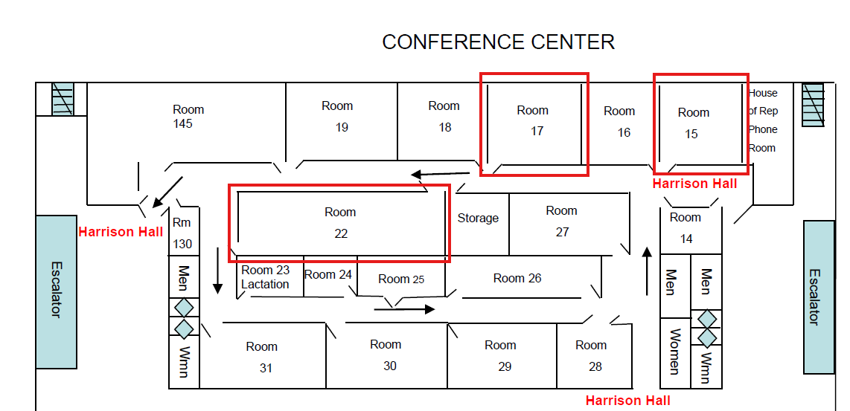

Slide 27
RFP TITLE
Term of the Contract:
Key Dates
Deadline to Submit Written Questions | MONTH XX, 20XX by 3:00 PM Eastern Time
Deadline to Submit Intent to Bid Form | MONTH XX, 20XX by 3:00 PM Eastern Time
Response to Written Questions/Amendments | MONTH XX, 20XX
Submission Due Date/Time | MONTH XX, 20XX by 3:00 PM Eastern Time
Submission of Reference Check Forms | MONTH XX, 20XX by 3:00 PM Eastern Time

Slide 28
Statewide IV&V Services
Term of the Contract:
Key Dates
Deadline to Submit Written Questions | MONTH XX, 20XX by 3:00 PM Eastern Time
Response to Written Questions/Amendments | MONTH XX, 20XX by 3:00 PM Eastern Time
Submission Due Date/Time | MONTH XX, 20XX by 3:00 PM Eastern Time
Submission of Reference Check Forms | MONTH XX, 20XX by 3:00 PM Eastern Time

Slide 29
Questions?

Slide 30
REQUEST FOR PROPOSAL 27-88394
Indiana State Library E-Rate Services
Daniela Cacho

Slide 31
Purpose of the RFP
E-Rate is the discount telecommunication program available to schools and libraries from the federal government. The Indiana State Library holds the master contract for the Indiana public library E-Rate consortium.
Currently, approximately 144 public Library systems are members of the Public Library Internet Consortium with circuits in approximately 255 locations across the state.

Slide 32
Scope of Work
The FSSA PSO utilizes custom, agency specific training modules to comply with privacy and security standards for CMS ARC_AMPE, the Social Security Administration, HIPAA, State and FSSA policies and procedures, and numerous Federal requirements under 45 CFR §164.530 (b)(1-2).
The DFR utilizes custom, division specific modules to train staff on services provided by DFR to qualifying Hoosiers.
Objectives:
Procure a solution that provides a user friendly interface for management staff and trainees. Ensure the tool can easily load FSSA developed training modules and retain all historical training modules from the current solution.
Provide quick access to audit logs for management to prove user training compliance and completion.
Ensure seamless retention of historical user training records with the ability to audit in real time, and robust reporting.
The current e-learning management system is an out of the box solution, that allows FSSA to load FSSA created training modules into the tool. Learning paths are used to set educational milestones for users. The current solution includes built-in analytics to track course status and completion. It allows for verifying compliance, scheduling reports, and has a searchable, cloneable, fully customizable system reports. FSSA can keep track of license usage, onboarding progress, exam scores, phishing click-through and report rates. The current solution also provides a Security Awareness training package, containing curated ready to use training modules.
The current system is intuitive and easy to use, with little engagement with the vendor outside of helpdesk support. FSSA staff creates training modules, loads modules into the solution, and enrolls users.

Slide 33
Scope of Work
The purpose of this solicitation is to select a respondent that can satisfy the State’s need for Internet access and WAN Connectivity Services to Public Library Internet Consortium members. It is the intent of the Indiana State Library (“ISL”) to contract with a respondent that provides quality Internet access and WAN Connectivity Services for public libraries.
SOW:
The service must include all customer premises equipment (included but not limited to router (updated as needed at no charge to the library), switches, and circuit terminations). A Service Level Agreement (SLA) must include customer support that will be available 24 hours a day, 7 days a week, 365 days a year. Customer support shall be offered via a toll-free phone number, email, live chat, site visits, and through an online ticketing system/help desk with dedicated network support. The service must include training on the equipment for each library and 24 hours a day, 7 days a week, 365 days a year network monitoring. The SLA must have a guaranteed QOS with a 99.99% network availability for each circuit. The network should provide commitments to frame/packet loss, network latency, and jitter. Additional features, such as resiliency or DDoS protection should also be described. The service should provide reporting tools that should be easy to use. Support must provide annual consulting with libraries to review and analyze bandwidth usage and a dedicated Account Services Manager who will identify and understand the library’s needs, will participate in the technology-planning process, as appropriate, and ensure current and future requirements are met. Support shall include consulting regarding E-Rate deadlines and rule changes and shall include assistance with E-Rate forms, Program Integrity Assurance questions, and appeals. This includes post contract forms, and vendors shall not be a part of any competitive bidding processes beyond supplying bids.
Vendor must be able to provide service statewide to all public libraries. Where fiber circuits exist, the vendor must be able to continue that technology. Where current network Quality of Service technology exists, the vendor must demonstrate ability to continue that technology. In the event that the consortium's current IP addresses must be changed as the result of this RFP, the vendor will provide separate pricing to make any necessary on-site configuration changes to customer owned equipment.

Slide 34
Term
The term of the contract shall be for a period of four (4) years from the date of contract execution. There may be zero (0) year renewal for a total of four (4) years at the State’s option.

Slide 35
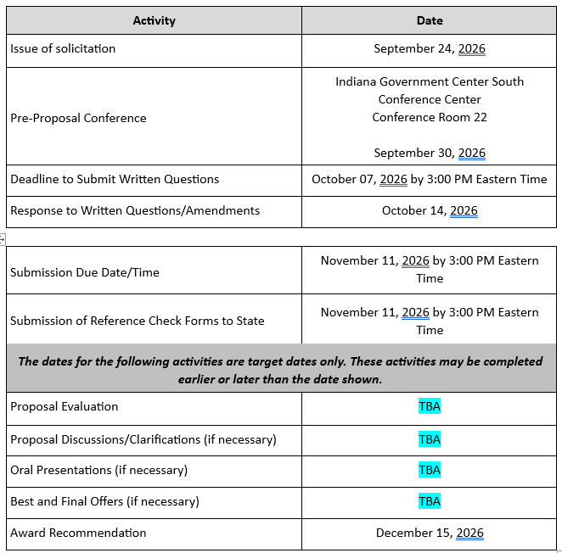
Key Dates
Please go to Room 2 for the Pre-Proposal Conference

Slide 36
Evaluation Criteria
Criteria | Points
Adherence to Mandatory Requirements | Pass/Fail
2. Management Assessment/Quality (Business and Technical Proposal) | 39 points
3. Cost (Cost Proposal) | 41 points
4. Buy Indiana | 5 points
5. Indiana Veteran Owned Small Business Subcontractor Commitment | 5 points (1 bonus point is available, see Section 3.2.7)
Total | 90 (91 if bonus awarded)

Slide 37
Questions?

